Slide 1


null
Brek Roman 19213
Vasilev Pavel 19213
Patrushev Borya 19213
Tarasov Artёm 19214
【=◈︿◈=】
nsu-null/null

Slide 2

GAME INFO

Slide 3


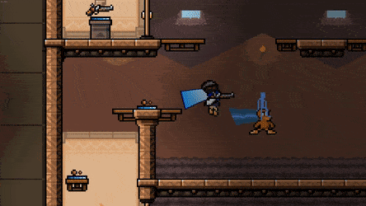



GENRE
Dynamic 2d action pvp-multiplayer platformer with lots of fast rounds.
The environment in the game is dynamic and players can interact with it.
The game is located in cyberpunk setting, and the graphic style can be described as "pixel art".
There are augmentations on the map for characters("perk")
And the cyberpunk style is reflected in the style of the weapons, both melee and ranged.

Slide 4

FEW WORDS ABOUT LORE
Everything happens in the future(2288), where there are flying cars, augmentations, AI and e.t.c.
There are 2 casts: high and low
The protagonist is a member of the lower caste
His goal is to win the tournament and do justice

Slide 5
TECH

Slide 6
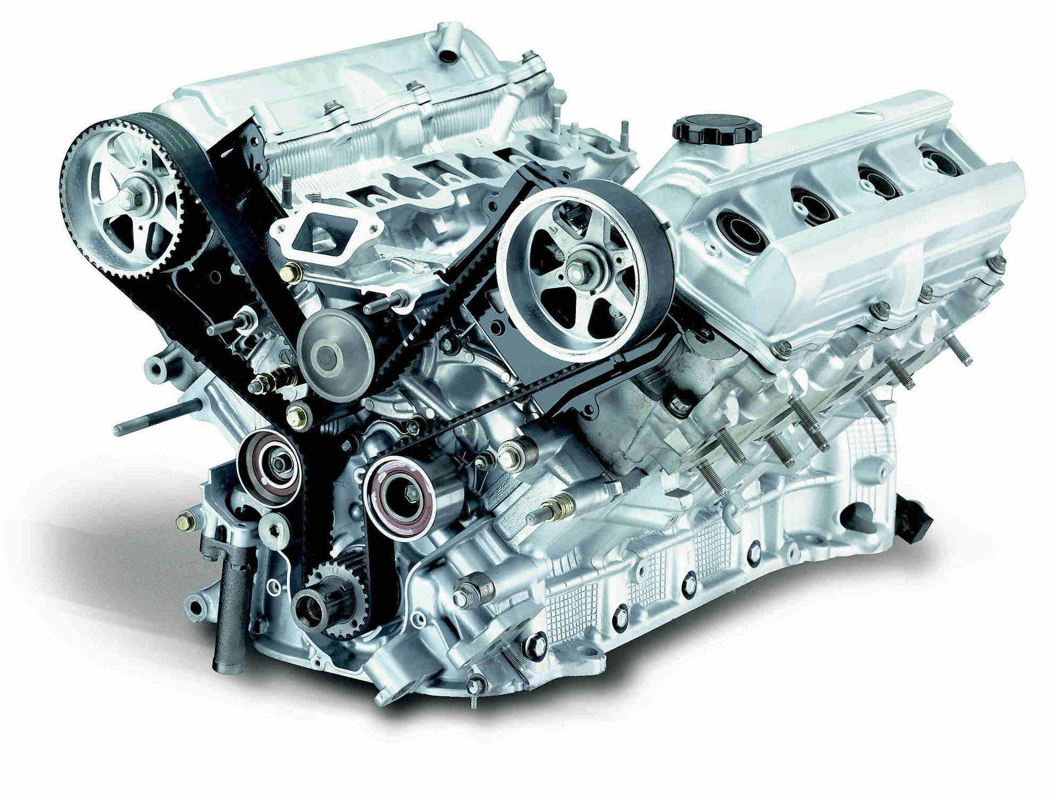
ENGINE
Scene (serializable piece of data which dictates what a game level is)
GameObject (serializable piece of data which dictates what a game level is )
Component (part of a GameObject which is aware of the scene and the event loop)
SceneLoader (singleton object / a set of functions in the global scope that can substitute the currently loaded scene for some other)
MainLoop (a singleton which takes care of updating the Scene)
Entity-Component pattern was widely used (for GameObject and Component relationship)

Slide 7
NETWORKING
Server Arbitrator - entity to which the client connects when he wants to go online. Responds for:
Creating game simulation
Control game simulation
Give info (CODE) about how to connect to game simulation

Slide 8
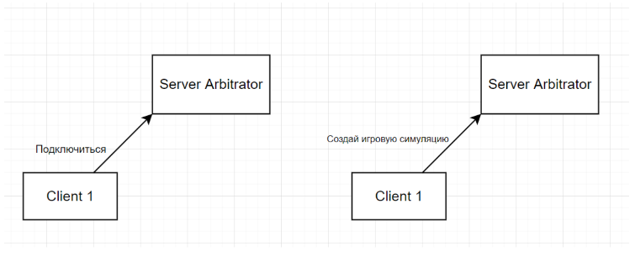
NETWORKING

Slide 9
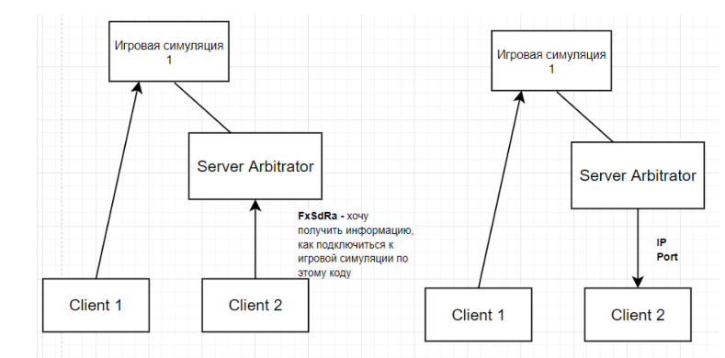
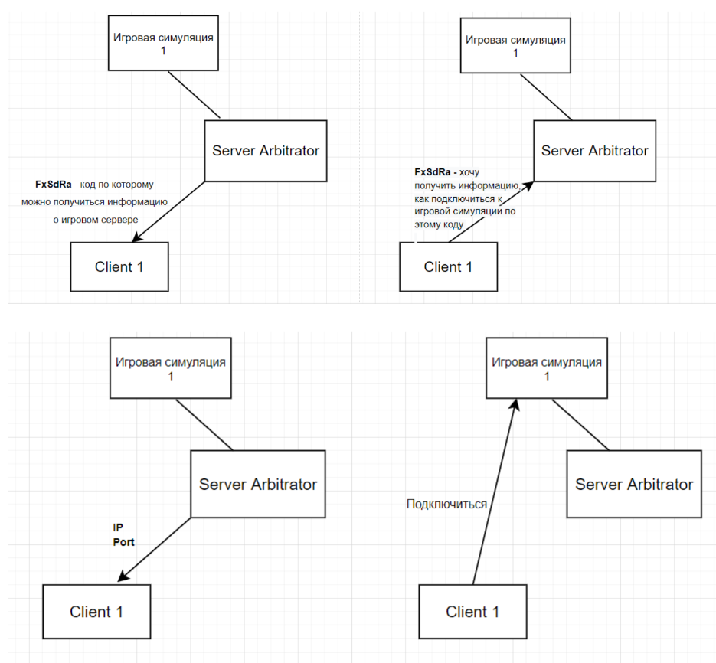
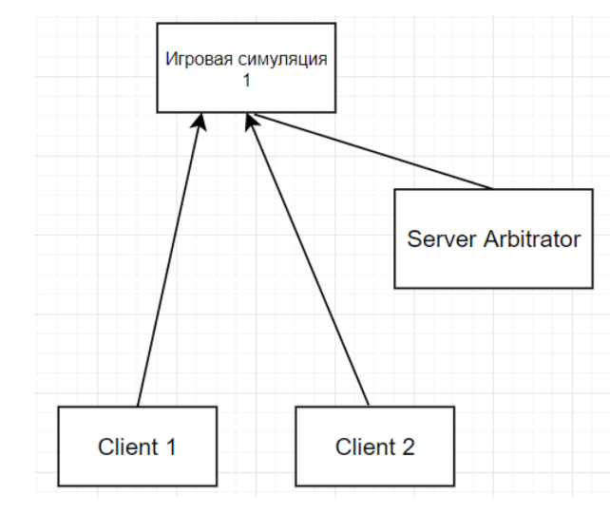
NETWORKING

Slide 10
NETWORKING
Client — Game Simulation
Pub/Sub pattern on client side
Every game object can subscribe on arbitrary message type
It receives messages it subscribed to from personal queue
Then he can handle them on the update state

Slide 11






FLOW
C++
SFML (API to various multimedia components in PC)
BOX2D (2D Physics Simulation Engine)
PROTOBUF (serialization protocol)
PLOG (logging library)
GOOGLE TEST (test runner)

Slide 12
Problems

Slide 13
Problems
C++ memory management and overall language learning
Architecture choices
Serialization problems
The way we can run game simulation on the server side with sending physics objects
NullPointerException

Slide 14
PLANS

Slide 15

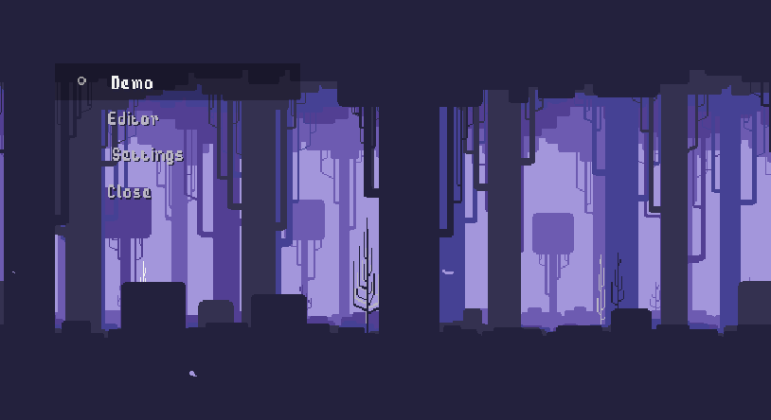
PLANS
Engine(refactoring)
Networking (refactoring + features)
Business Logic
Level Builder
Parallax
Music/SFX
Features

Slide 16
DEMO

Slide 17
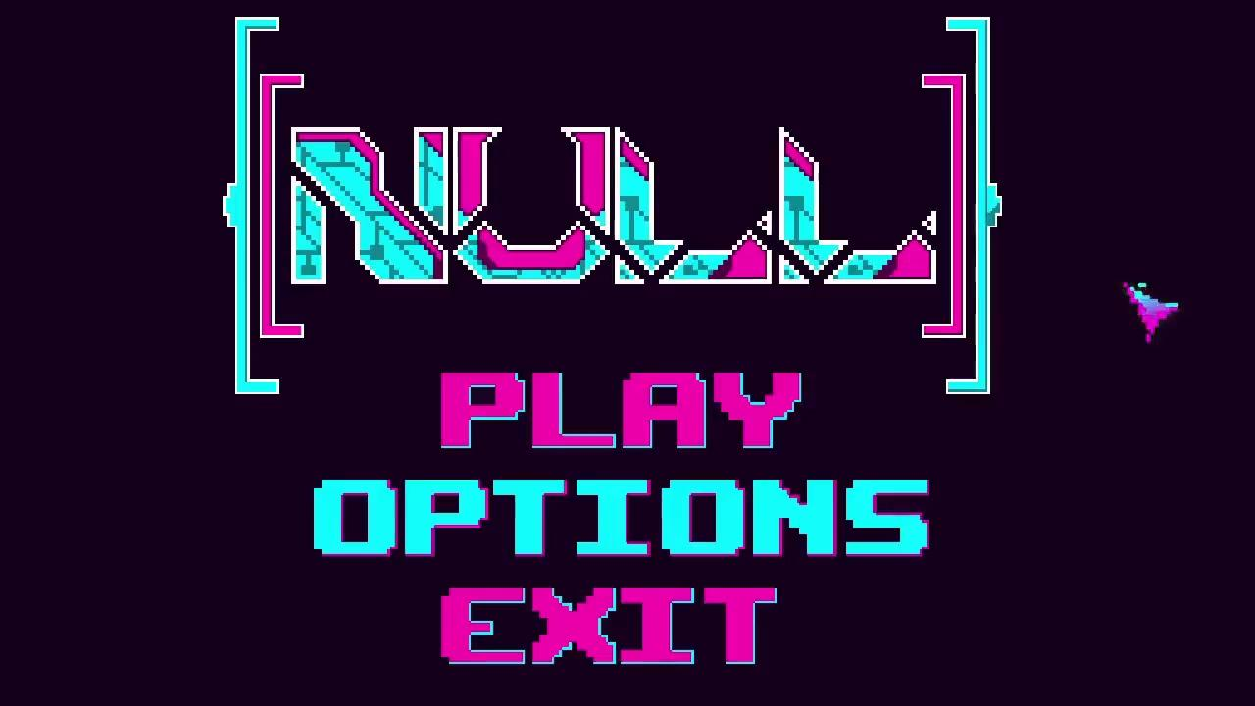

Slide 18
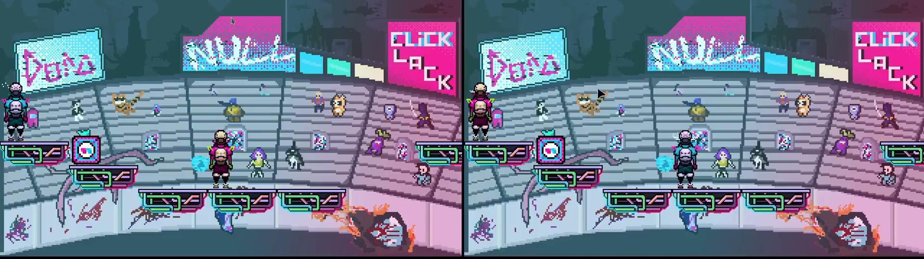

Slide 19
THANK YOU FOR YOUR ATTENTION!

